Slide 1
From:
Spreadsheet Model of SOFC Electrochemical Performance
Larry Chick, Jeff Stevenson and Rick Williford
August 29, 2003
Data Provided by:
Steve Simner
Kerry Meinhardt

Slide 2
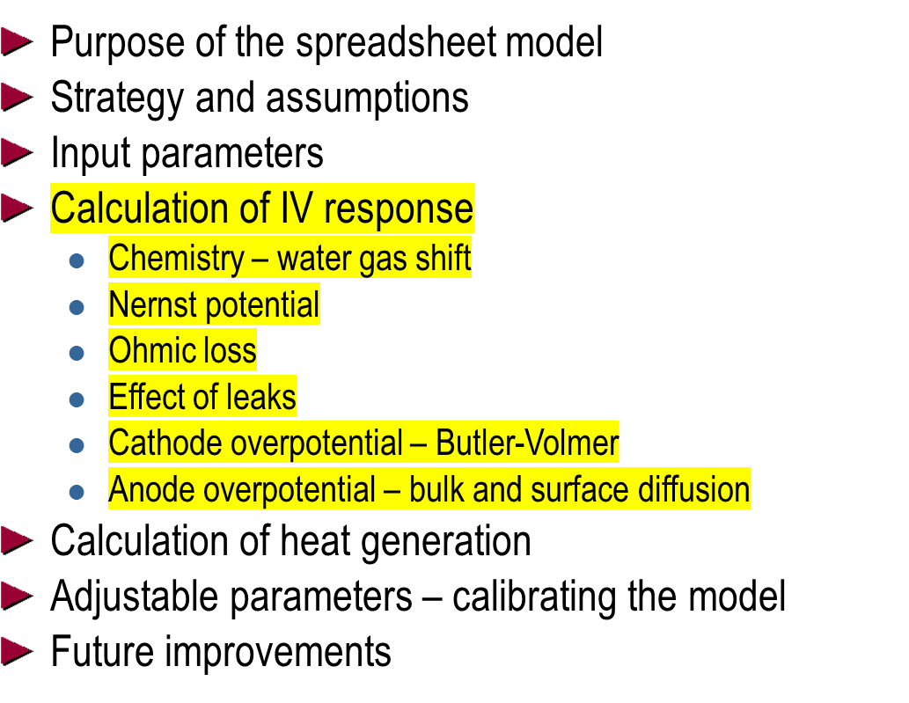
Outline

Slide 3
Purpose
“One-dimensional” stack calculations
Stack module for systems modeling
Electrochemical algorithm embedded into CFD or FEA codes for three-dimensional modeling of stacks
Provide guidance for stack component development – How can we improve performance?

Slide 4
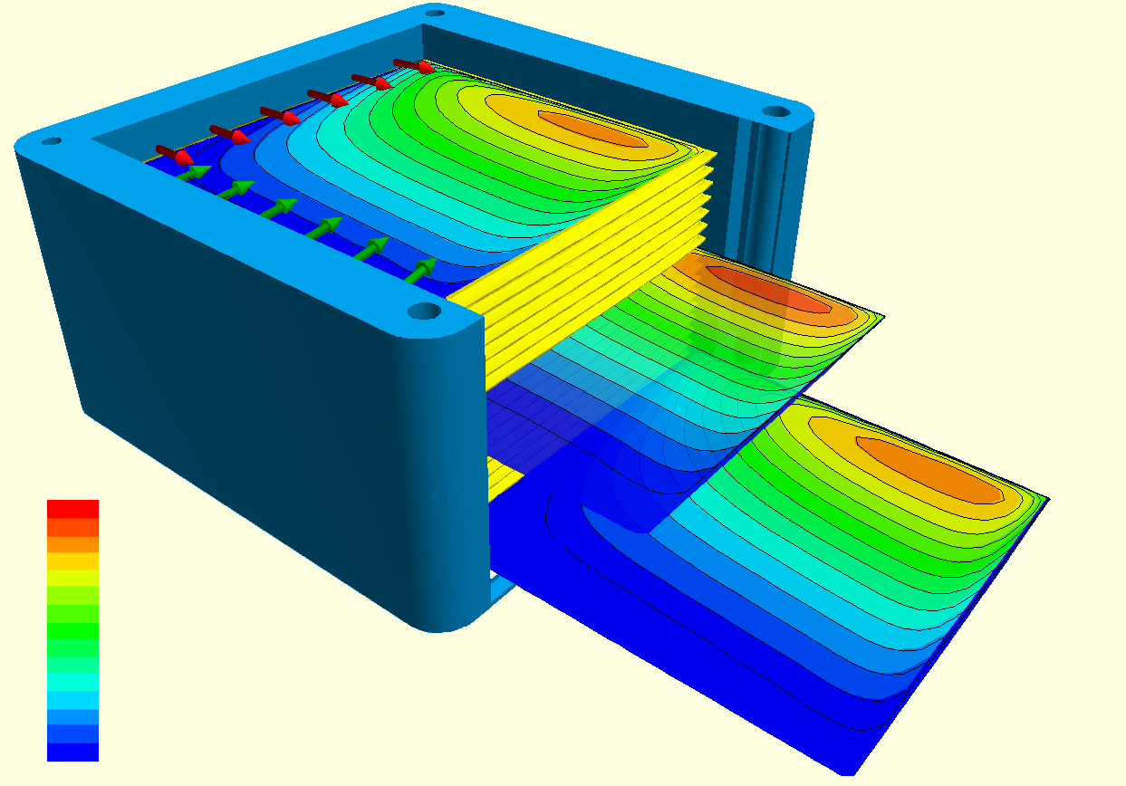
Strategy and Assumptions
Unit cell
  homogeneous temperature
  homogeneous gas compositions
air
cathode
electrolyte
anode
fuel
interconnects (not shown)

Slide 5

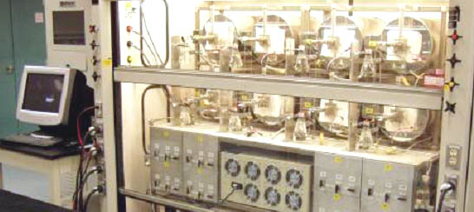
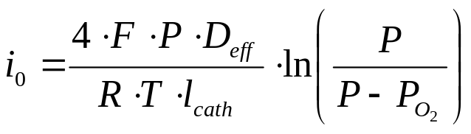
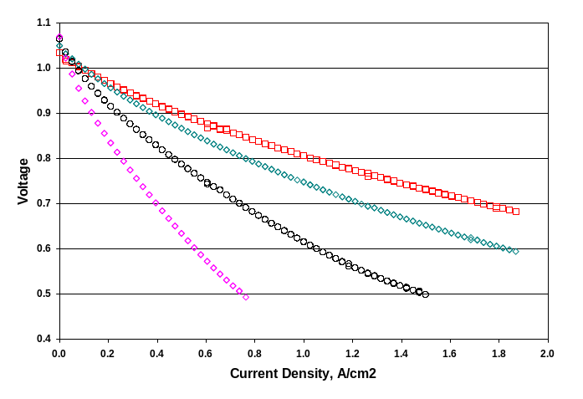
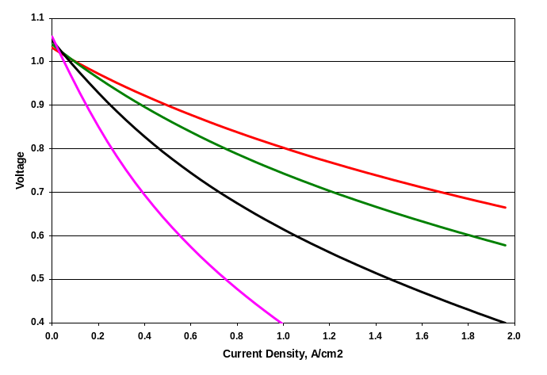
Strategy and Assumptions, cont.
Theoretically based
Empirically calibrated
button cell data for range of operating conditions
calibrated model

Slide 6
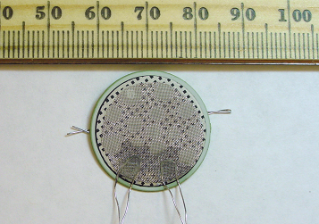
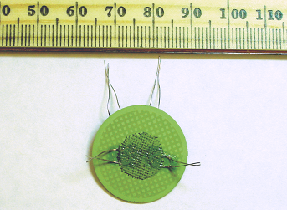
Button Cell Experimental Set-Up
~3cm² active area
P
t
M
e
s
h
V
l
e
a
d
I
l
e
a
d
P
t
G
r
i
d
P
t
c
u
r
r
e
n
t
c
o
l
l
e
c
t
o
r
T
h
e
r
m
o
-
c
o
u
p
l
e
C
a
t
h
o
d
e
C
e
r
i
a
Y
S
Z
Anode substrate
i
n
t
e
r
l
a
y
e
r
A
l
u
m
i
n
a
C
a
t
h
o
d
e
P
t
I
-
V
W
i
r
e
s
s
e
a
l
i
n
g
c
e
m
e
n
t
N
i
c
u
r
r
e
n
t
c
o
l
l
e
c
t
o
r
A
l
u
m
i
n
a
C
a
t
h
o
d
e
P
t
I
-
V
W
i
r
e
s
t
u
b
e
A
n
o
d
e
S
u
b
s
t
r
a
t
e
N
i
M
e
s
h
V
l
e
a
d
I
l
e
a
d
A
n
o
d
e
P
t
I
-
V
W
i
r
e
s

Slide 7
Starting Points for SOFC Theory:
J.W. Kim, A.V. Virkar, K.Z. Fung, K. Mehta, .SC. Singhal, J. Electrochem. Soc. 146, 69 (1999).
NQ Minh, T. Takahashi, Science and Technology of Ceramic Fuel Cells, Elsevier Publishers, Amsterdam (1995).
E.L. Cussler, Diffusion: Mass Transfer in Fluid Systems, 2nd Edition, Cambridge University Press, Cambridge, UK (1977) Chapter 3.
I. Reiss and J. Schoonman, in CRC Handbook of Solid State Electrochemistry, CRC Press, Boca Raton, 291 (1977).
Y. Jiang and A.V. Virkar, J. Electrochem. Soc. 150, 7 (2003).

Slide 8
Input Parameters
Stack materials properties and dimensions
  active area
  component thickness
  porosity
Stack operating conditions
  temperature
  fuel composition
Adjustable parameters, used in calibrating model to fit experimental data sets

Slide 9
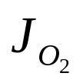
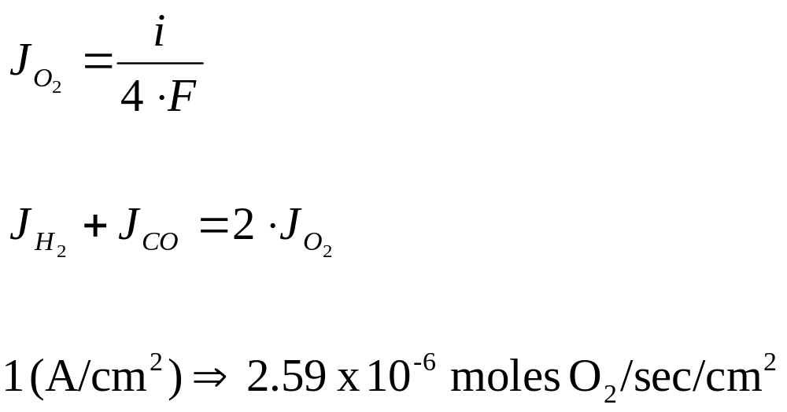
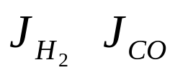
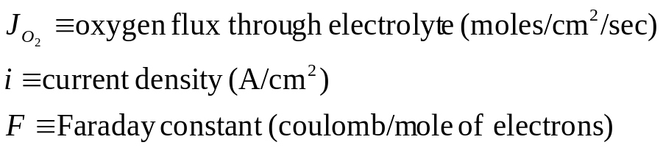
Chemical Calculations
Calculations based on current density.
Current density establishes rate of oxygen transport through electrolyte, which establishes rate of fuel consumption:

Slide 10
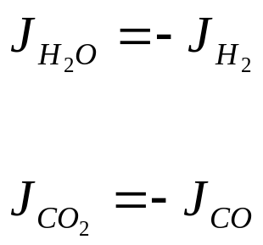
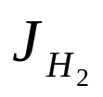
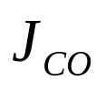

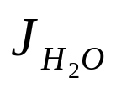
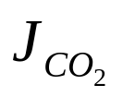
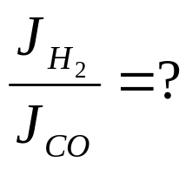
Chemical Calculations, cont.
Product fluxes are opposite of reactant fluxes
Ratio of H2 oxidation to CO oxidation is unknown.

Slide 11
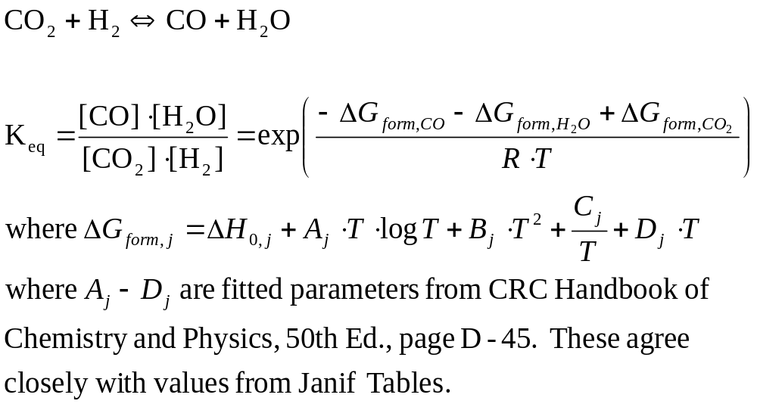
Chemical Calculations, cont.
Assume fuel gas is always in equilibrium with regard to the water-gas shift reaction:

Slide 12
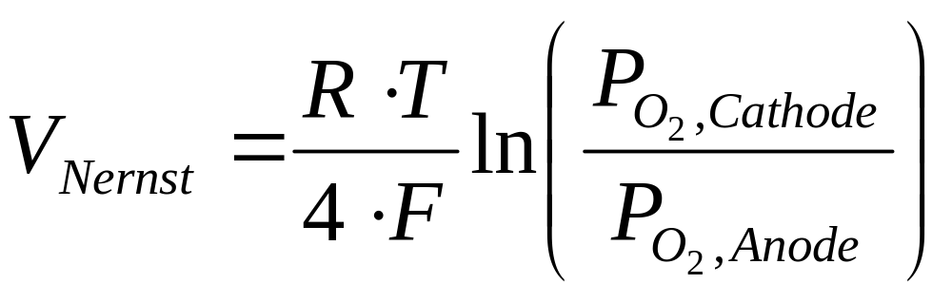

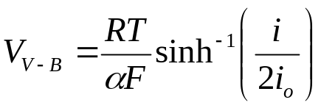
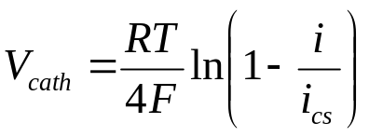
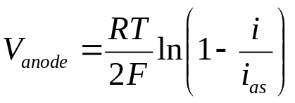
Discussion of Basic Model
Chemical calculations:
  The Cell Voltage

Slide 13
Nernst Potential
Currently based on PO₂s in bulk gases
Next version based on interfacial concentrations

Slide 14
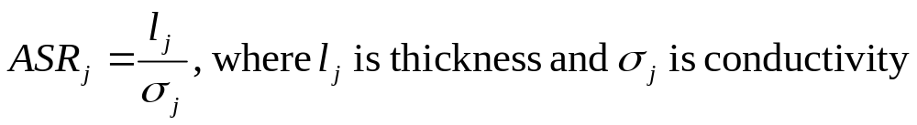
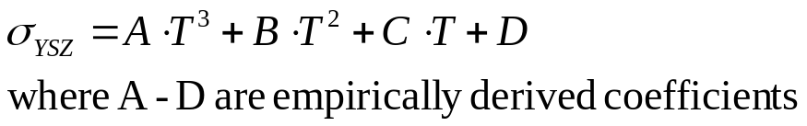
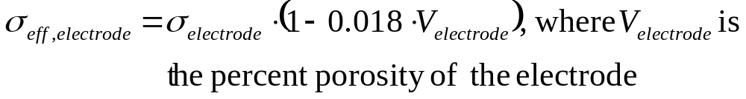
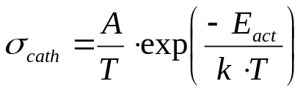
Ohmic Losses
Resistive loss of cell components
  Area specific resistance (ASR):
  Voltage loss due to ohmic resistance:
  electrolyte (considerable resistance)
  electrodes (relatively small resistance)

Slide 15
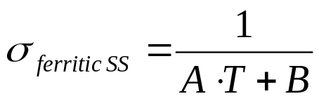

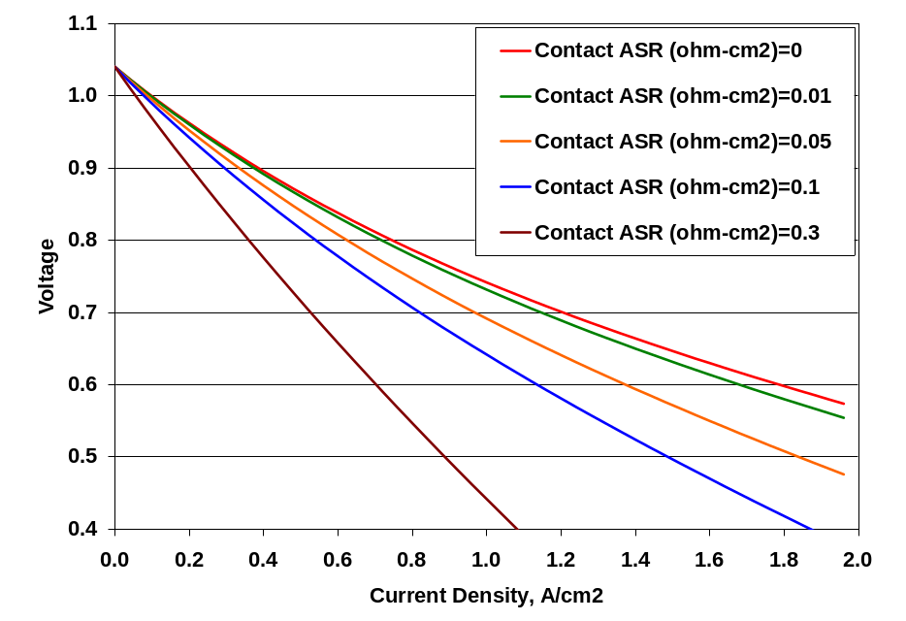
Ohmic Losses, cont.
Resistive loss of interconnect components and interfaces
  conductivity of stainless steel
  additional ohmic resistance, such as contact resistance due to formation of oxide scale (Next version has T dependence)

Slide 16
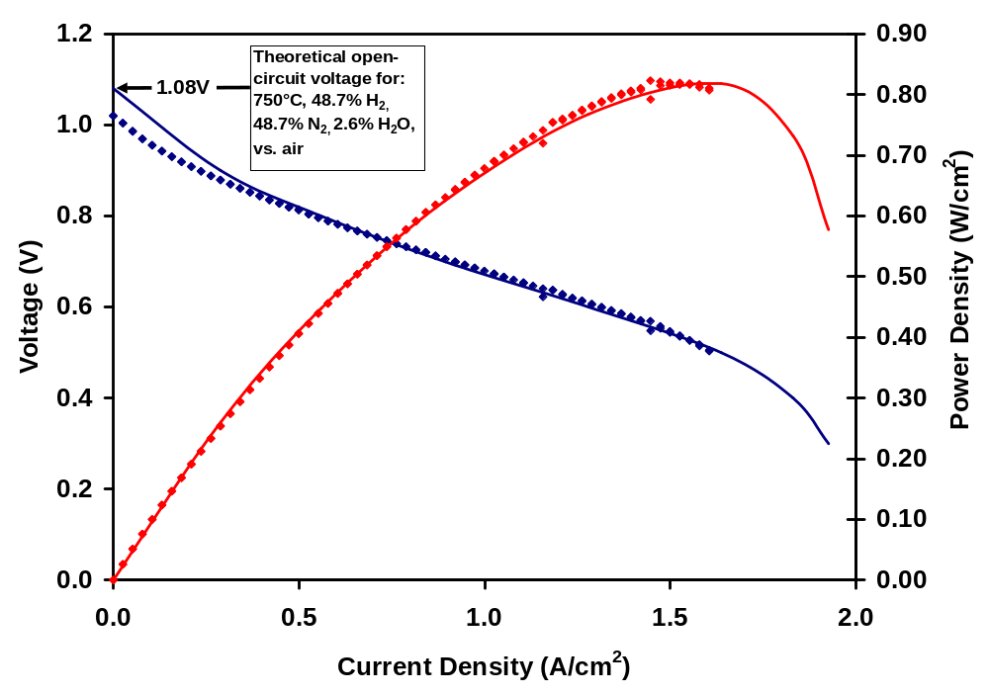
Effect of Leak on I-V Curve
Two cells were tested, one a 2.5cm button cell, known to have a small leak from anode to cathode, through porous ceramic seal (filled diamonds).
The other, a 7cm x 7cm cell with gas-tight glass seal (lines).
Cells had identical materials, processing, and operating conditions.
Comparison of I-V curves shows that the effect of the leak is “washed out” as the current increases.

Slide 17
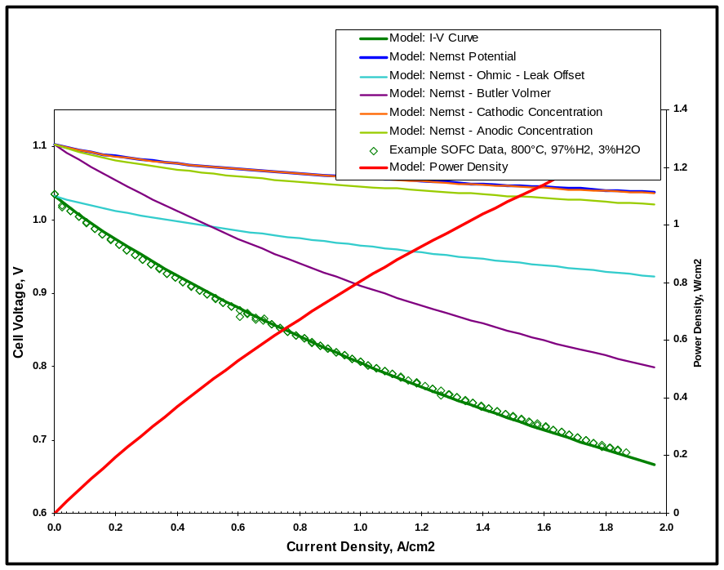
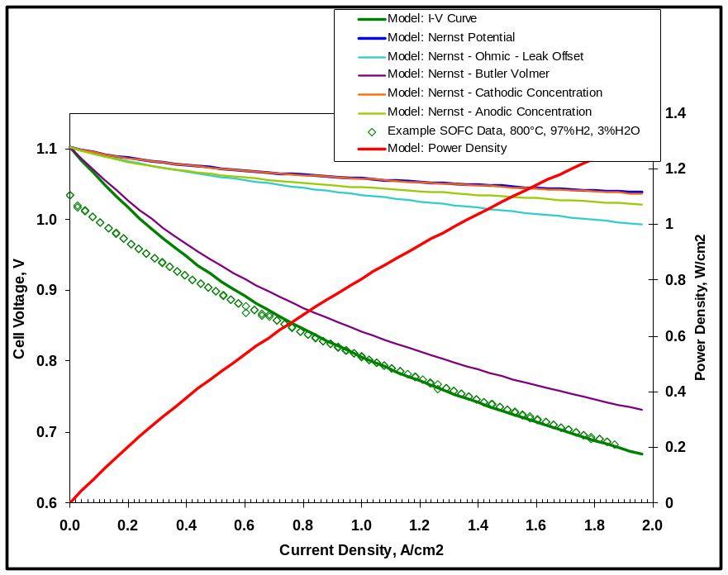
Effect of Leak on I-V Curve
Basic model subtracts constant voltage at all currents to compensate for leak effect.
Based on recent data, recommend assuming effect of leak is overcome as current increases.

Slide 18
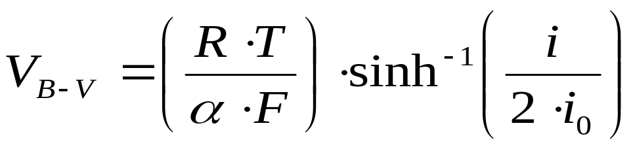
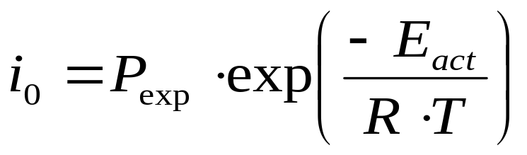
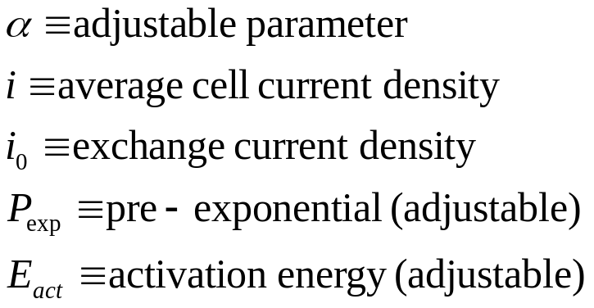
Butler-Volmer Approximation
Electrode charge-transfer overpotential
Combined for both electrodes
Three adjustable parameters for calibration

Slide 19
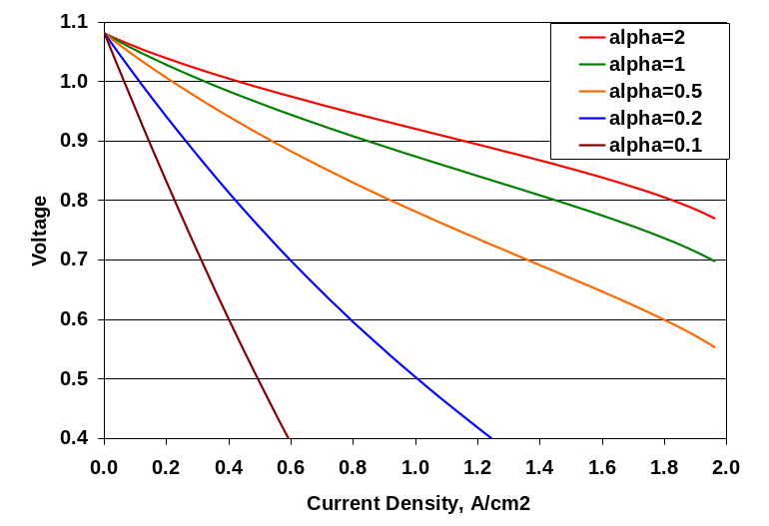
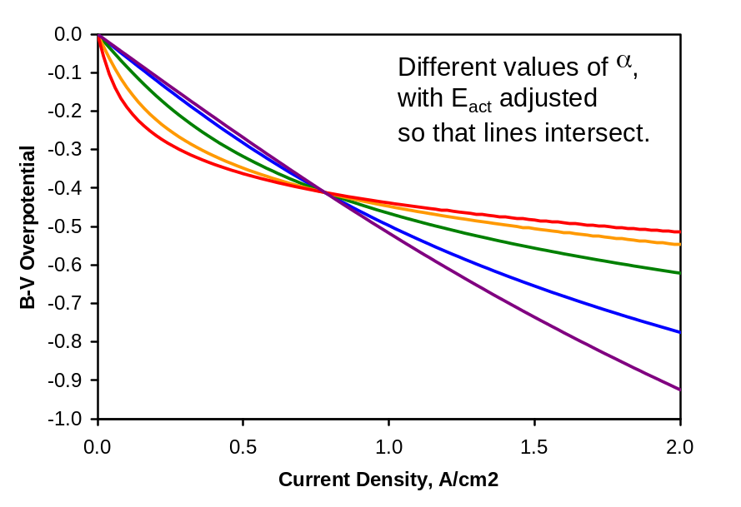
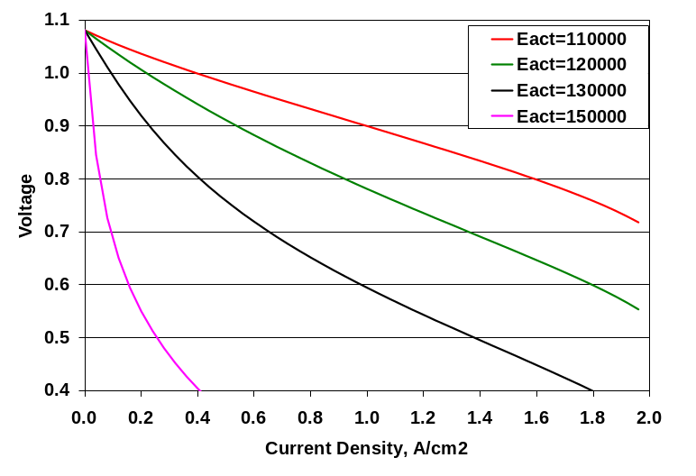
Effects of adjusting Butler-Volmer Parameters
Slope, curvature and temperature dependence

Slide 20
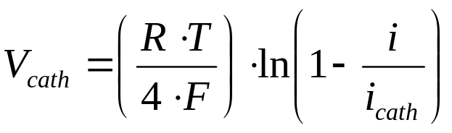
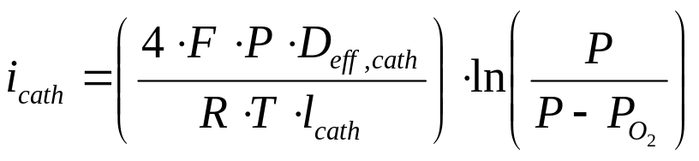
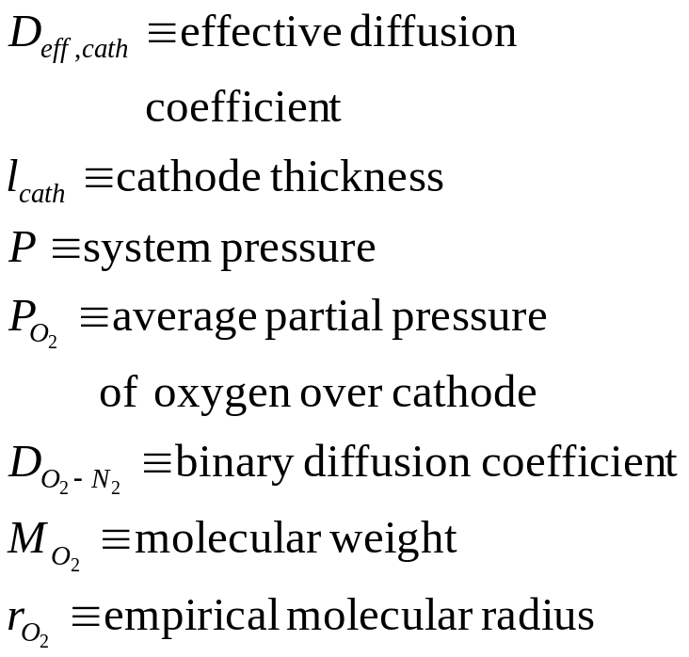
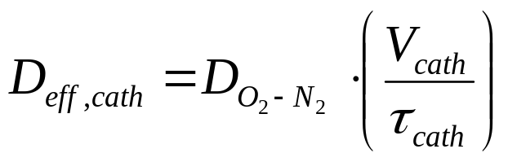
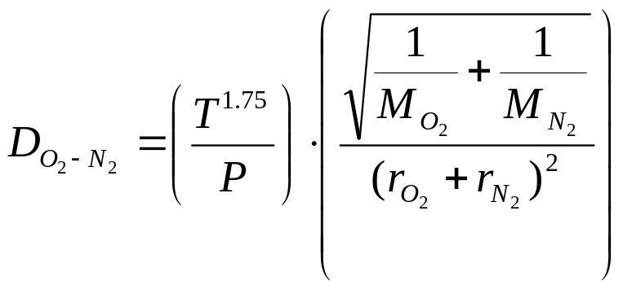
Cathode Diffusion Loss
Loss due to depletion of O₂ at the cathode-electrolyte interface
No adjustable parameters

Slide 21
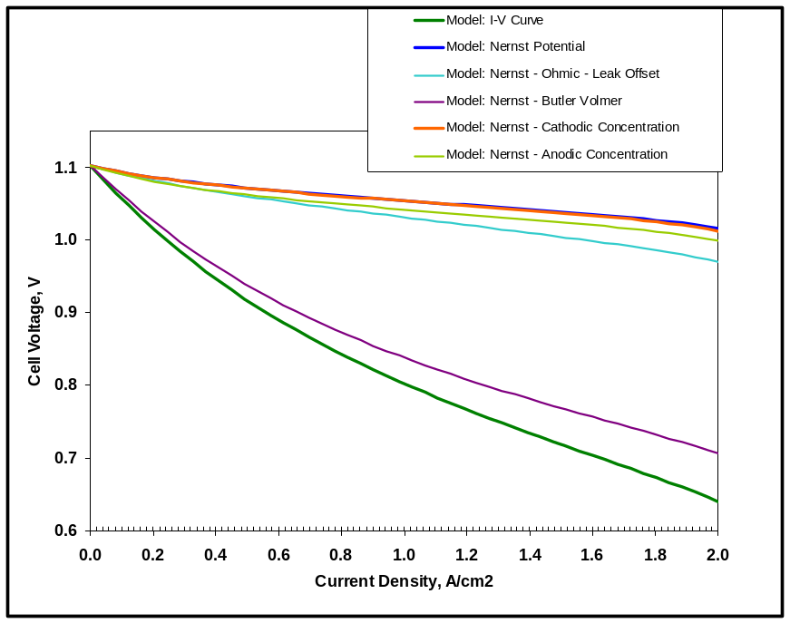
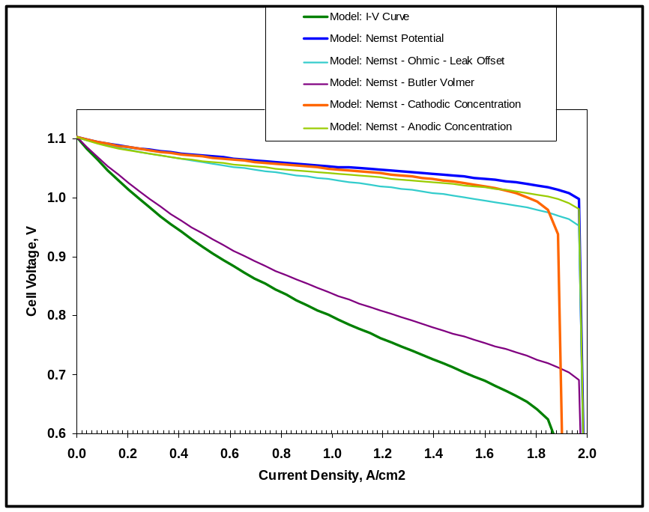
Cathode Diffusion Loss, Cont.
No significant overpotential until oxygen is almost completely gone.
90% O₂ utilized at 2 A/cm²
50 μm cathode, 30% porosity, τ=2.5
No discernible effect
100% O₂ utilized at 2 A/cm²
50 μm cathode, 30% porosity, τ=15
Significant effect at high currents.

Slide 22
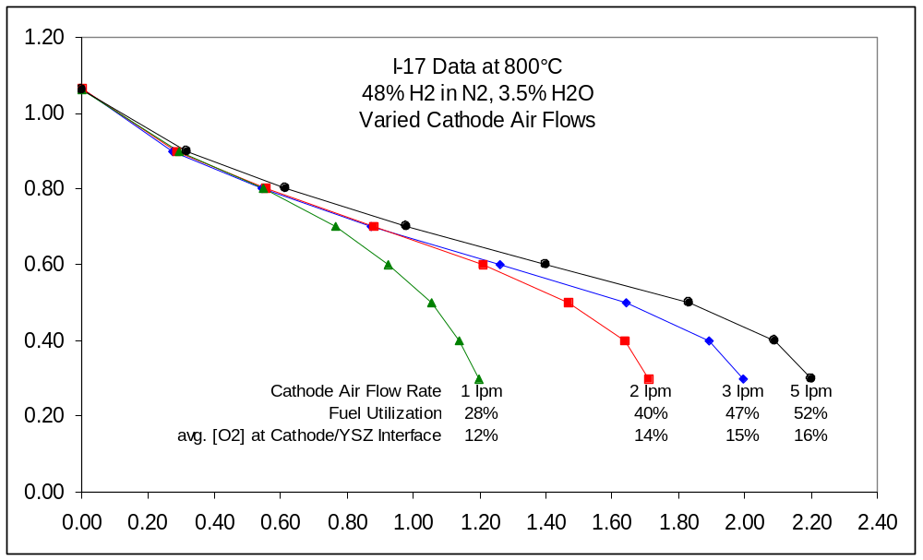
Next version accounts for realistic cathode-generated limiting current.

Slide 23
Anode Overpotential
Outline
• Parallel reactions (H₂ & CO), solve by electrical
circuit analogy
• Limiting currents for concentration polarization
• Products - classical pore diffusion model
• Reactants - surface adsorption/diffusion model

Slide 24
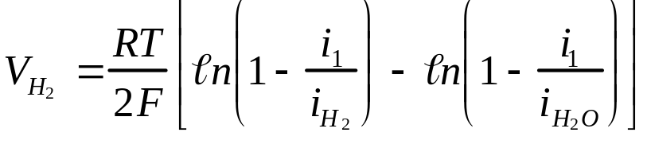
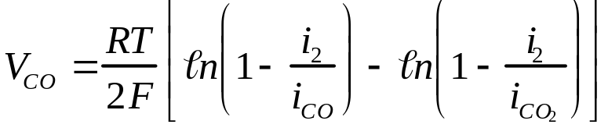
Anode Overpotential
Two simultaneous reactions
  H₂+1/2O₂->H₂O and CO+ 1/2O₂->CO₂
Solve by electrical circuit analogy
i_{total}
i_{1,} v₁
i_{2,} v₂
Kirchoff’s Laws: i₁+i₂=i_{total}, v₁=v₂
(Cells M106-U131)

Slide 25
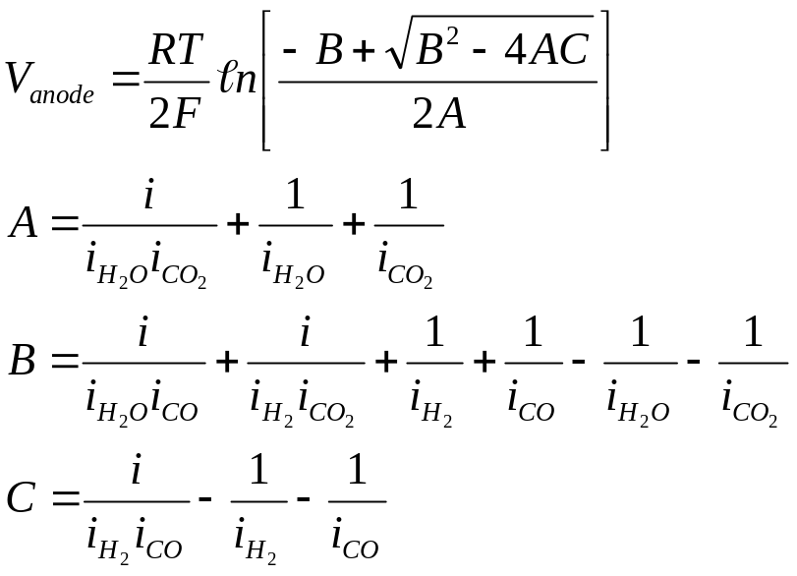
Anode Overpotential
Solve by electrical circuit analogy
Kirchoff’s Laws: i₁+i₂=i_{total}, v₁=v₂
The familiar quadratic solution
(Cells M106-U131)

Slide 26
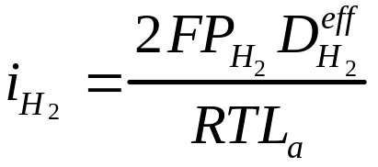

Anode Overpotential
Each branch of circuit treats reactants (H₂,CO) and products (H₂O,CO₂), eg,
Each term contains a ‘limiting current’ (i_{H2}, i_{H2O} )
  Defined by partial pressure (P_{H2}), effective diffusivity (D^{eff}), anode thickness (L_{a})
(Cells M106-U131)

Slide 27
Anode Overpotential
The limiting currents are derived for open circuit conditions, and assume that the reactant concentrations approach zero in the gas immediately above the reactive sites.
This may not be true, but serves as a working approximation to investigate the importance of other mechanisms in the context of previous models, thus maintaining a connection (benchmark) to prior models.

Slide 28
Anode Overpotential
Limiting current differs for reactants and products
H₂ controlled by adsorption & surface diffusion to TPB, H₂O by bulk diffusion through pores
The difference is how you treat the effective diffusivity
Reactant
Product
(Cells M106-U131)

Slide 29



Anode Overpotential
• Product (H₂O) limiting current controlled by
bulk diffusion through pores (a classical model)
• φ=porosity, τ=tortuosity, x=mole fraction,
P=total pressure, M=molec. wt., r=molec. radius
(Cells W63-AD88)

Slide 30
Anode Overpotential
Concentration polarization due to limited reactant (H₂) supply rates may be caused by surface adsorption and diffusion mechanisms very near the TPBs, rather than by bulk diffusion mechanisms through the porous ceramic.
The following is a proposed model currently under development.

Slide 31

Enthalpy Calculations – Oxidation of Fuel
Enthalpy changes related to fuel oxidation are calculated using standard "textbook" thermodynamics, taking advantage of the fact that enthalpy is a state function. Fuel gas is “virtually” cooled to RT, oxidized at RT, then heated to outlet temperature. (Cells C137-P195)
The starting point for the calculations is the fuel gas composition as equilibrated at the inlet temperature expressed in flow rate for each species (Cells C13-C17).
Step 1) The anode inlet gas mixture is cooled down to room temperature.
  e.g: H₂ (T_{inlet}) → H₂ (298 K)
  Similar calculations for other species (CO, H₂O, CO₂, N₂)
  ΔH_{cooling} = ∑ ΔH_{i} i = H₂, CO, H₂O, CO₂, N₂

Slide 32
Enthalpy Calculations – Oxidation of Fuel
Step 2) The appropriate amounts of H₂ and CO (based on inlet and outlet fuel concentrations) are oxidized at room temperature using room temperature enthalpies of formation for products and reactants.
  CO + 1/2 O₂ → CO₂ ΔH₁ = ΔH_{f} (CO₂) - ΔH_{f} (CO)
  H₂ + 1/2 O₂ → H₂O ΔH₂ = ΔH_{f} (H₂O)
ΔH_{ox} = ΔH₁ + ΔH₂

Slide 33

Enthalpy Calculations – Oxidation of Fuel
Step 3) The anode outlet gas mixture is heated to the outlet temperature.
  e.g: H₂ (298 K) → H₂ (T_{outlet})
  Similar calculations for other species (CO, H₂O, CO₂, N₂)
  ΔH_{heating} = ∑ ΔH_{i} i = H₂, CO, H₂O, CO₂, N₂
Step 4) The net enthalpy for fuel oxidation is obtained by summing the enthalpies from Steps 1-3:
  ΔH_{net} = ΔH_{cooling} + ΔH_{ox}+ ΔH_{heating}

Slide 34
Enthalpy Calculations – Oxidation of Fuel
Step 5) The electrical power produced by the stack (as calculated by the model, see Cell I8) is then subtracted from the calculated enthalpy (Cell G175) to yield the net sensible heat produced by the cell/stack:
  Q_{oxid} = ΔH_{net} - Work_{elect}

Slide 35

Enthalpy Calculations – Cathode Air
Changes in enthalpy associated with the removal of heat by cathode air as it passes through the stack are calculated using the same methodology as for fuel oxidation.
Starting point for calculation is inlet cathode air flow rate and temperature; oxygen removed via electrolyte membrane is subtracted from oxygen calculation:
  N₂ (T_{inlet}) → N₂ (T_{outlet})
  Similar calculation for oxygen
Q_{cath} = ΔH_{cath} = ΔH_{N2} + ΔH_{O2}

Slide 36
Enthalpy Calculations – Final Answer
The net sensible heat generated by the cell/stack is obtained by adding together the enthalpy of fuel oxidation and the enthalpy of cathode air heating.
Q_{net} = Q_{oxid} + Q_{cath}
Result is shown in Cell K6 (with incorrect units in Jan 03 release– should be W instead of W/cm² )
Remember that heat losses due to radiation/convection form stack walls are not included!!!
Note: The thermodynamic values for the various reactants and products in the preceding calculations were taken from Appendix C of Stoichiometry and Thermodynamics of Metallurgical Processes by Y.K.Rao, Cambridge, 1985

